Slide 1
Lecture 6
Unified Process

Slide 2
Agenda
Define an iterative and adaptive process.
Define fundamental concepts in the Unified Process.

Slide 3
UP
The Unified Process has emerged as a popular software development process for building object-oriented systems.
The Unified Process (UP) combines commonly accepted best practices, such as an iterative lifecycle and risk-driven development, into a cohesive and well-documented description.

Slide 4
Important Idea
The iterative lifecycle is based on the successive enlargement and refinement of a system through multiple iterations, with cyclic feedback and adaptation as core drivers to converge upon a suitable system.
The system grows incrementally over time, iteration by iteration, and thus this approach is also known as iterative and incremental development

Slide 5
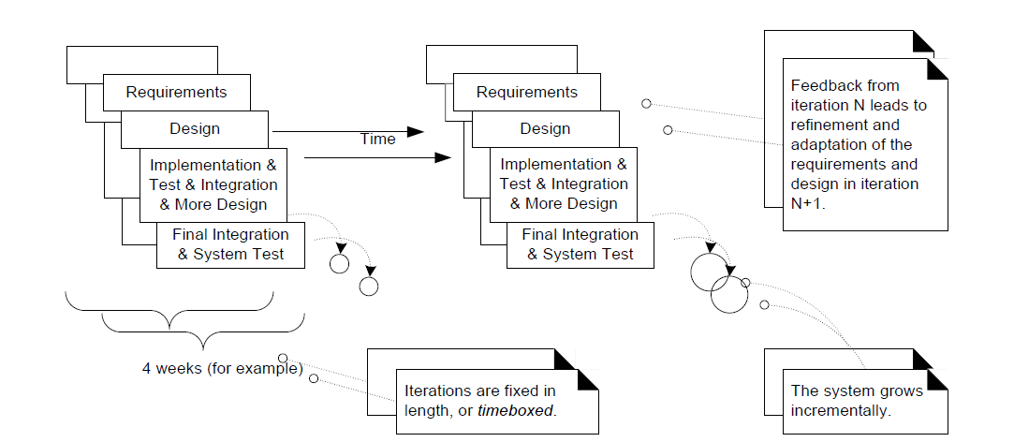
Iterative and incremental development.

Slide 6
Highlights
There is neither a rush to code, nor a long drawn-out design step that attempts to perfect all details of the design before programming.
A "little" forethought regarding the design with visual modeling using rough and fast UML drawings is done; perhaps a half or full day by developers doing design work in pairs.
The result of each iteration is an executable but incomplete system; it is not ready to deliver into production. The system may not be eligible for production deployment until after many iterations; for example, 10 or 15 iterations.

Slide 7
Contd..
The output of an iteration is not an experimental or throw-away prototype, and iterative development is not prototyping.
Rather, the output is a production-grade subset of the final system.
each iteration tackles new requirements and incrementally extends the system, an iteration may occasionally revisit existing software and improve it;

Slide 8
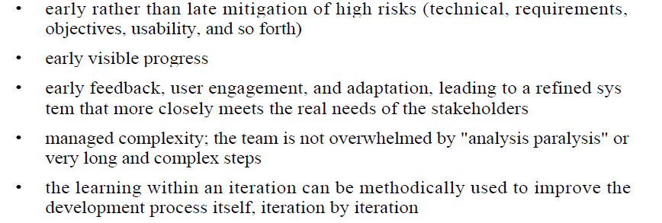
Benefits of Iterative Development

Slide 9
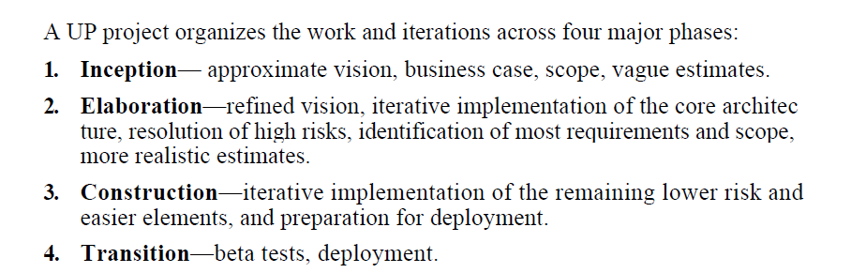
Phases

Slide 10
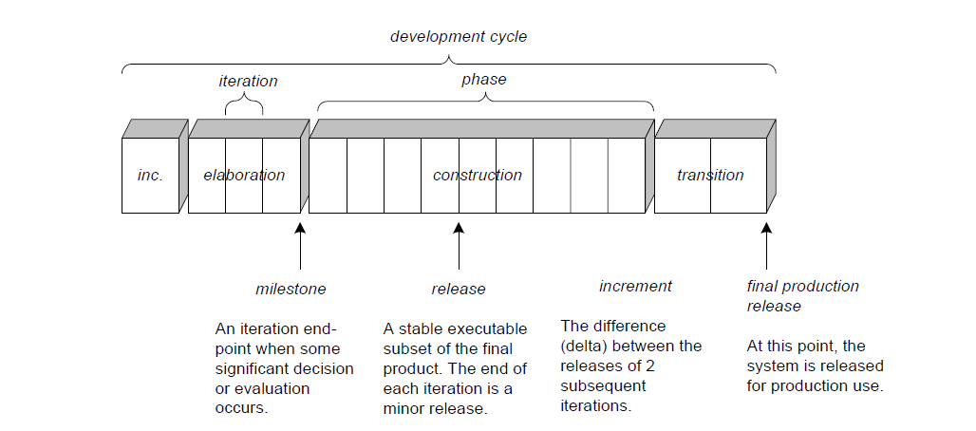
Schedule-oriented terms in the UP.

Slide 11
The UP Disciplines (was Workflows)
The UP describes work activities, such as writing a use case, within disciplines (originally called workflows).
In the UP, an artifact is the general term for any work product: code, Web graphics, database schema, text documents, diagrams, models, and so on.

Slide 12
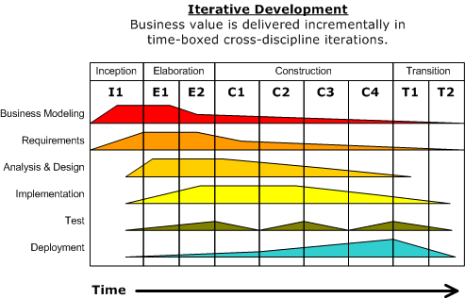
Disciplines and phases

Slide 13
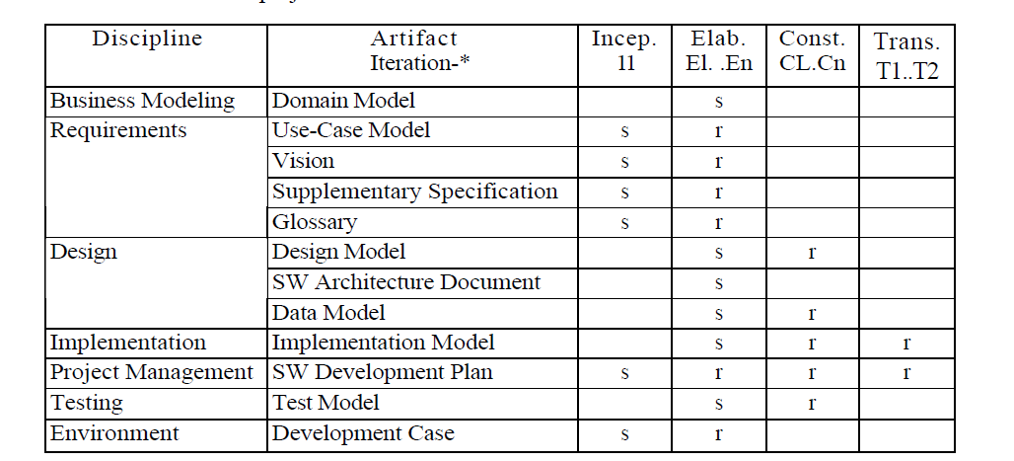
Sample Development Case of UP artifacts, s - start; r - refine

Slide 14
You Know You Didn't Understand the UP When...
You think that inception = requirements, elaboration = design, and construction = implementation (that is, superimposing a waterfall lifecycle on to the UP).
You think that the purpose of elaboration is to fully and carefully define models, which are translated into code during construction.
You try to define most of the requirements before starting design or implementation.

Slide 15
Contd..
You try to define most of the design before starting implementation; you try to fully define and commit to an architecture before iterative programming and testing.
A "long time" is spent doing requirements or design work before programming starts.
You think UML diagramming and design activities are a time to fully and accurately define designs and models in great detail, and of programming as a simple mechanical translation of these into code.

Slide 16
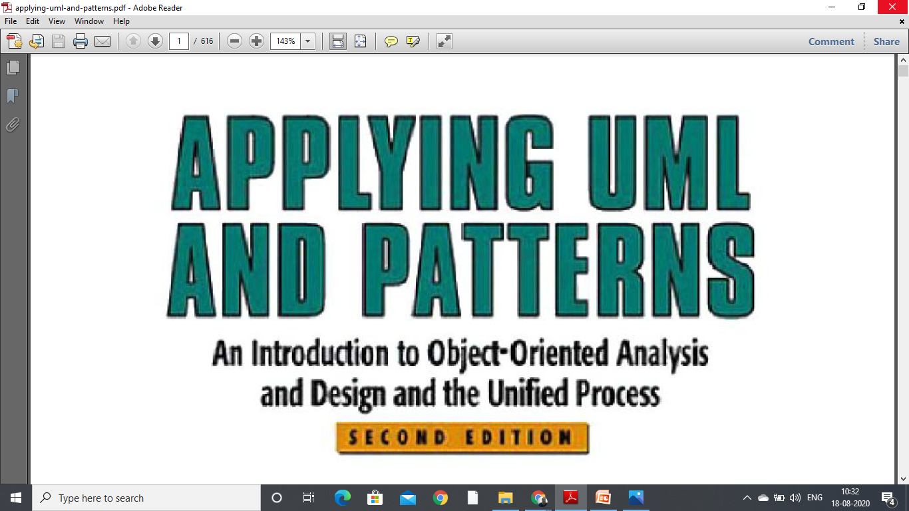
References

